Slide 1
Mass Moments of Inertia via Integration
Dr. Jacob Moore
Associate Professor of Mechanical Engineering
Penn State Mont Alto

Slide 2
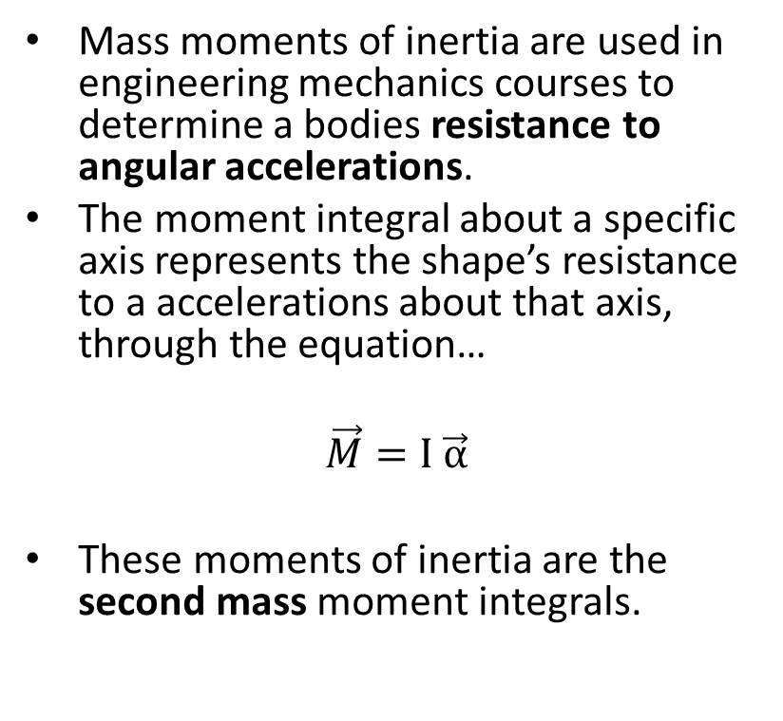
What is the Mass Moment of Inertia
Mass moments of inertia are used in engineering mechanics courses to determine a bodies resistance to angular accelerations.
The moment integral about a specific axis represents the shape’s resistance to a accelerations about that axis, through the equation…
$$\vec{M}=I \vec{α}$$
These moments of inertia are the second mass moment integrals.
α
M

Slide 3
Mass Moments of Inertia
The mass moment of inertia will be dependent upon the location and direction of the axis of rotation.
M
M
M

Slide 4




Second Mass Moment Intergrals and Angular Accelerations
The mass moment of inertia can be derived from the linear version of Newton’s Second Law
A point mass m on the end of a massless stick
$$F=m a$$
F
a
α
M
m
$$M=F∗d$$
$$a=α d$$
d
$$M=\left(m d^{2}\right) α$$

Slide 5
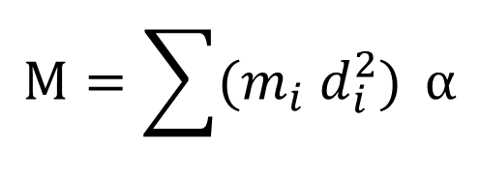
Mass Moments of Inertia and Angular Accelerations
If we had a number of masses, each on the end of a massless stick connected at some common point we would have the following relationship.
m
M
m
α
$$M=\sum{(m_{i} d_{i}^{2})} α$$
m

Slide 6
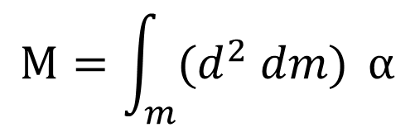
Mass Moments of Inertia and Angular Accelerations
For a solid body rotating about some axis, where we have mass distributed over a volume, we imagine the body as an infinite number of very small masses, each piece held in place by the mass around it.
α
M
$$M=\int_{m}^{ }{{(d}^{2} dm)} α$$

Slide 7
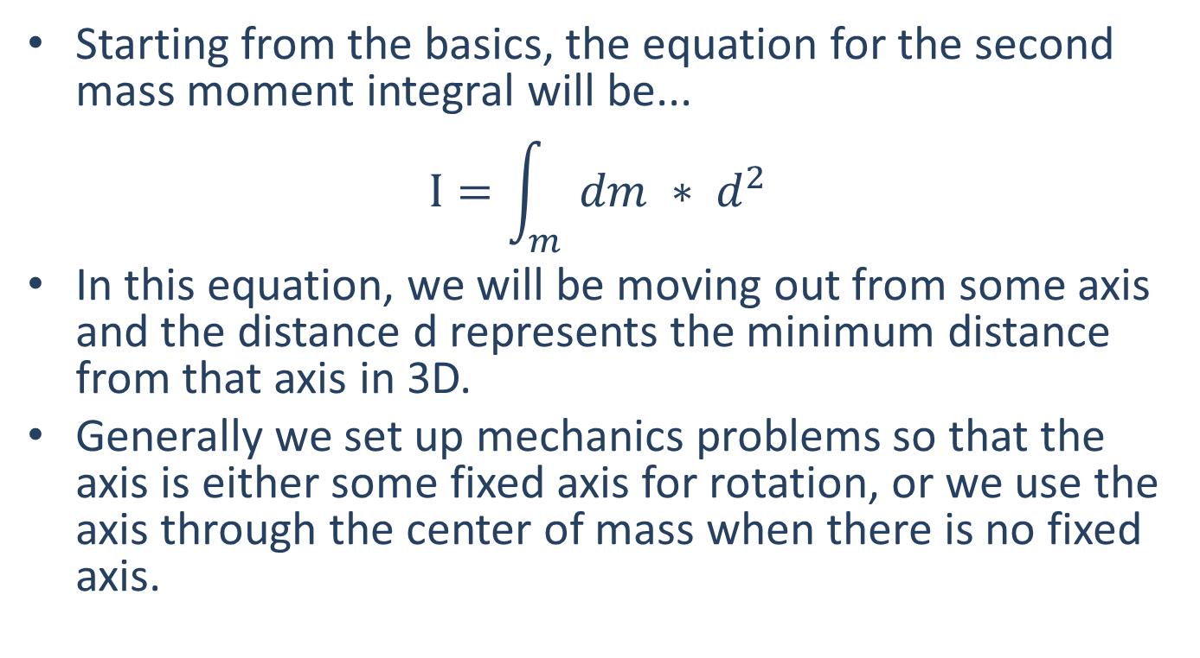
Finding the Mass Moment of Inertia via Integration
Starting from the basics, the equation for the second mass moment integral will be...
$$I=\int_{m}{dm ∗ d^{2}}$$
In this equation, we will be moving out from some axis and the distance d represents the minimum distance from that axis in 3D.
Generally we set up mechanics problems so that the axis is either some fixed axis for rotation, or we use the axis through the center of mass when there is no fixed axis.

Slide 8
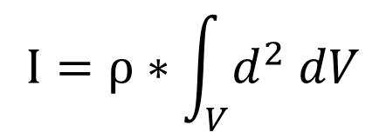
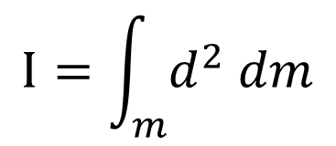
Finding the Mass Moment of Inertia via Integration
Next, if the body has a uniform density (aka it is made of a single material) then we can rewrite the mass as the density of the body times the volume of the body, and move the density (a constant) outside of the integral.
$$I=\int_{m}^{ }{d^{2} dm}$$
$$I=ρ∗\int_{V}^{ }{d^{2} dV}$$

Slide 9
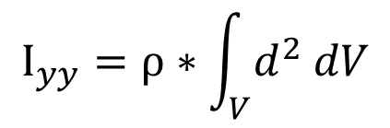
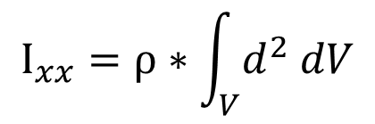
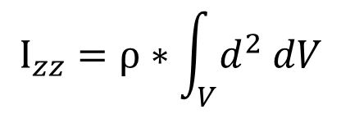
Finding the Mass Moment of Inertia via Integration
It is additionally important to realize that the distances in our equations will depend on the axis we choose for rotation.
For this reason, we need to keep track of the axis we are using for calculations, and to match this axis of rotation we are examining.
$$I_{xx}=ρ∗\int_{V}^{ }{d^{2} dV}$$
$$I_{yy}=ρ∗\int_{V}^{ }{d^{2} dV}$$
$$I_{zz}=ρ∗\int_{V}^{ }{d^{2} dV}$$
Moment of Inertia about the x axis
Distances measured from x axis
Moment of Inertia about the z axis
Distances measured from z axis
Moment of Inertia about the y axis
Distances measured from y axis

Slide 10
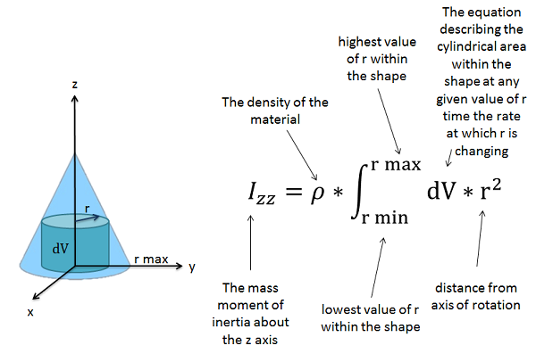
Finding the Mass Moment of Inertia via Integration

Slide 11
Thanks for Watching
See other engineering mechanics videos and access the full tool at…

Slide 12
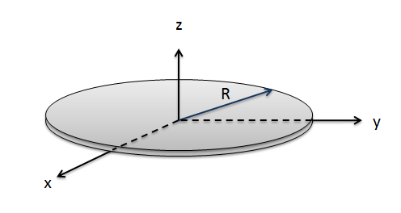
Mass Moment of Inertia Worked Example
A thin circular disc has a mass of 6 kg and a radius of .3 meters. Determine the mass moment of inertia for the disc about the z axis.

Slide 13
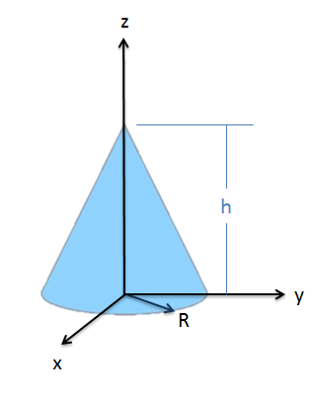
Mass Moment of Inertia Worked Example
Determine the mass moment of inertia about the z axis for this general cone with base radius R, height h, and mass m.

